Slide 1
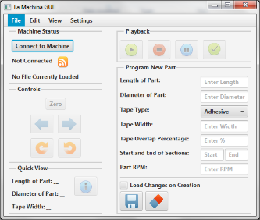
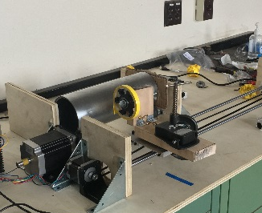
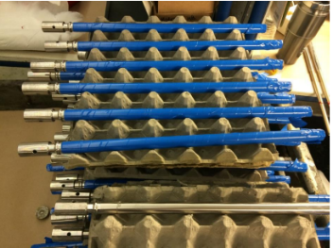
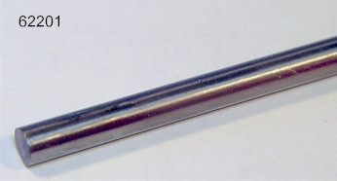
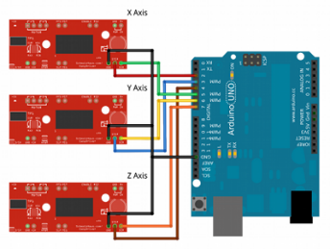
Control Logic
Part Needs to be Taped
Graphical User Interface
Electronic Control System
Motors and Tape System
Taped Part!
Dimensions
G – Code Input
Electric Signal
Physical Motion

